Slide 1
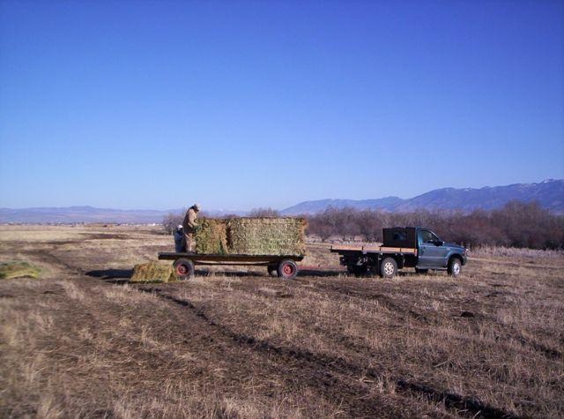
Household Environmental Health Risks to Rural Children – Risks and Perceptions of Risk
Patricia Butterfield, Dean
Washington State University College of Nursing
Spokane, Washington
OPHA October 2011

Slide 2
Multi-agent study of household environmental risks
Background
Risks
Intervention
Implications

Slide 3
Health Affairs May 2011
Reducing The Staggering Costs Of Environmental Disease In Children, Estimated At $76.6 Billion In 2008
Leonardo Trasande and Yinghua Liu

Slide 4
Environmental exposures in childhood
set the stage for illness over the lifespan

Slide 5

The child is the father of the man
William Wordsworth

Slide 6
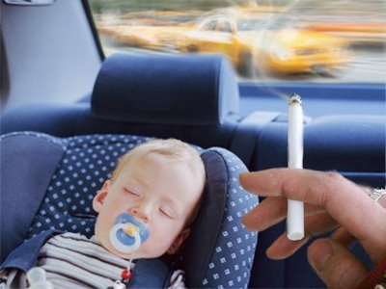

Slide 7
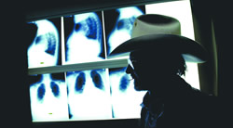

Slide 8
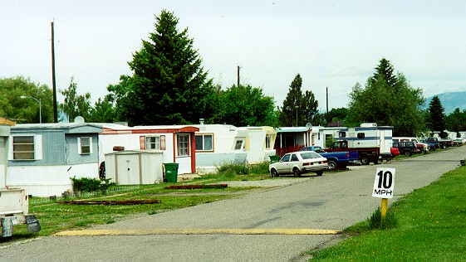

Slide 10
Rural environmental health is different

Slide 11
Purdy Creek fire, September 2001

Slide 12
background
Bunker Hill Smelter Complex, Smelterville, Idaho

Slide 13
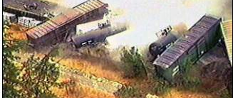
Background
Alberton chlorine spill

Slide 14
Aims
Identify frequency of household risks in unstudied communities
Test impact of a public health nursing intervention on
    Parents’ self-efficacy
    Parents’ precautionary adoption

Slide 15
Published online ahead of print Aug 11, 2011
American Journal of Public Health, 10.2105/AJPH.2011.300164
Patricia Butterfield, Wade Hill, Julie Postma,
Phillip Butterfield, Tamara Odom-Maryon

Slide 16
TERRA Framework:
Advances in Nursing Science , 2009.

Slide 17
Conceptualization based on:
- Thinking upstream
- Multiple-exposures multiple effects (MeMe) framework from World Health Organization (Briggs)

Slide 18
Macro-determinants: Ecologic- or societal- level antecedents
Physical-spatial
Economic-resources
Cultural-ideologic
EH Inequities: Differential distribution of resources available at the family level
EH risks
interventions
Risk perception
Proximal
outcomes
Distal
outcomes
The TERRA framework: Translational Environmental Research in Rural Areas

Slide 19
Team:
Patricia Butterfield. WSU. R01.
Wade Hill. MSU. K01.
Laura Larsson. OHSU dissertation.
Phil Butterfield. WSU. EPA and water analysis work.
Julie Postma. UW T32.
Public health personnel at Gallatin City County Health Department and Whatcom County Health Department.
Thank you to all….

Slide 21
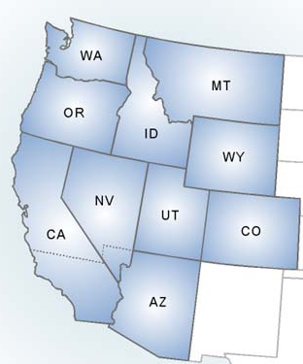
Sites included Gallatin County, Montana, and Whatcom County, Washington
Whatcom
Gallatin

Slide 22
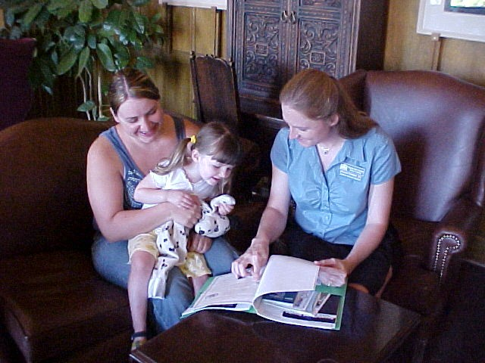
Inclusion Criteria
Child age 7 or younger
Potable water from a non-municipal source
Income <250% of poverty

Slide 23
testing
Household tests |  | Biomarkers
Airborne radon |  | Blood lead
Carbon monoxide |  | Salivary cotinine
In wall humidity as a proxy for mold growth risk
Water

Slide 24
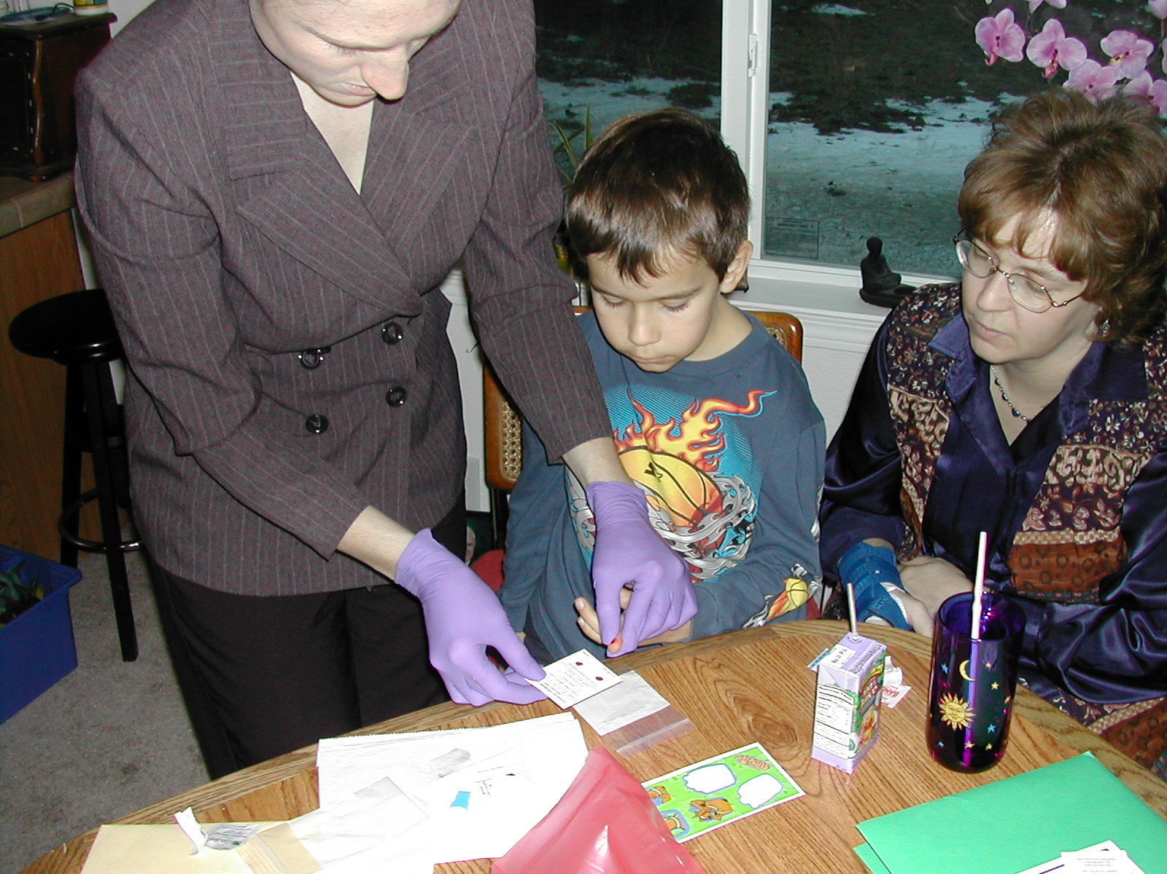
Testing child for blood lead

Slide 25
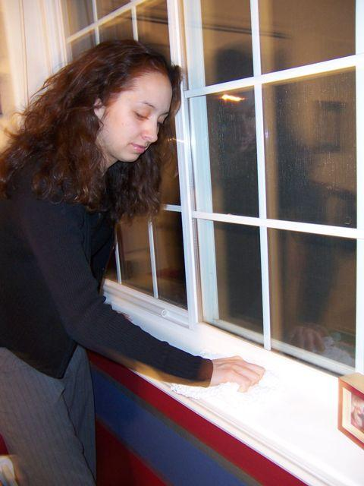
Incorporate test results into an intervention:
--multi-agent focus
-addressed low to medium literacy levels
--focus on practical actions

Slide 26


Slide 27
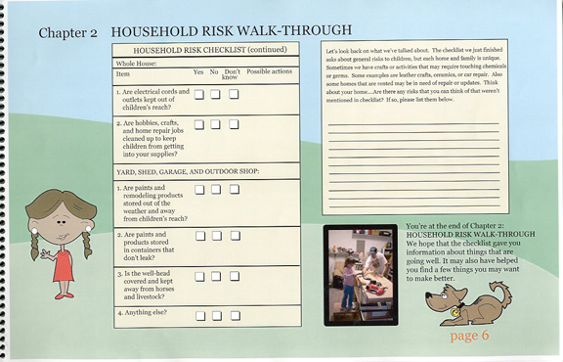

Slide 28
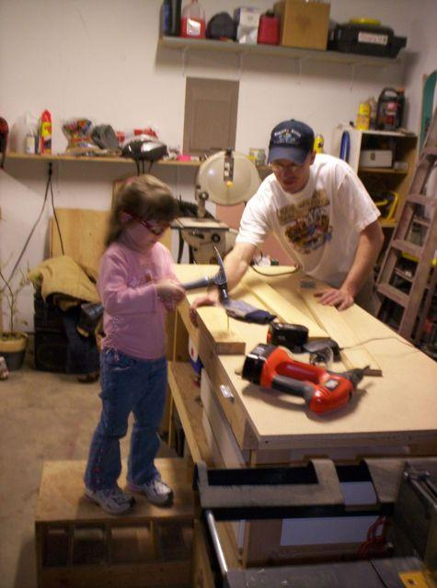
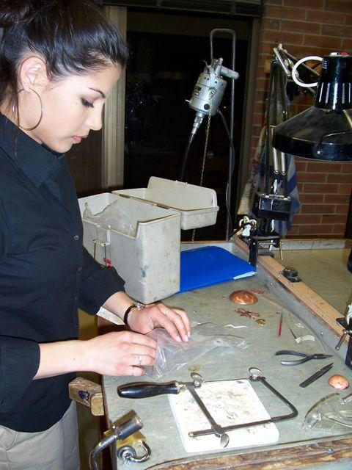

Slide 29
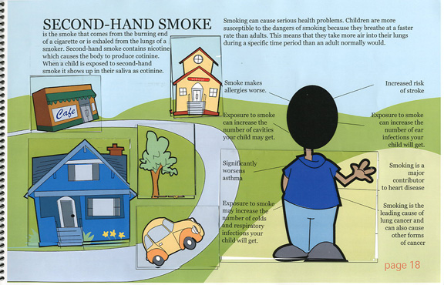
Child’s photo is inserted to personalize the intervention;
“windows” include information and test results

Slide 30
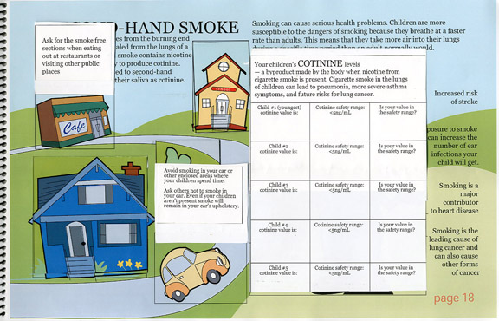
“Window” open with text results provided to mother

Slide 31
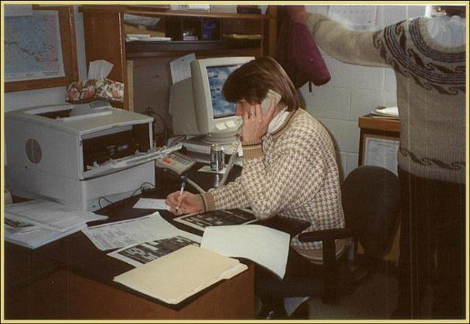
Local public health nurses delivered intervention during 4 home visits
Contracted with environmental health personnel at health department

Slide 32
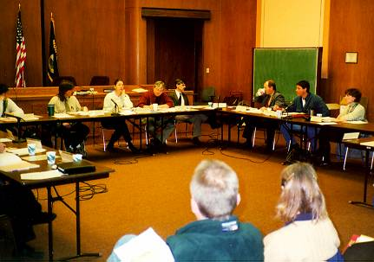
Gallatin City County Health Department Board Meeting

Slide 33
235 parents (households) participated
Intervention group = 119
Control group = 116
399 children ages 0-7

Slide 34
93% female
91% non-Hispanic White
Mean age =32.9yrs
Mean years education=15.2
60% owned home

Slide 35
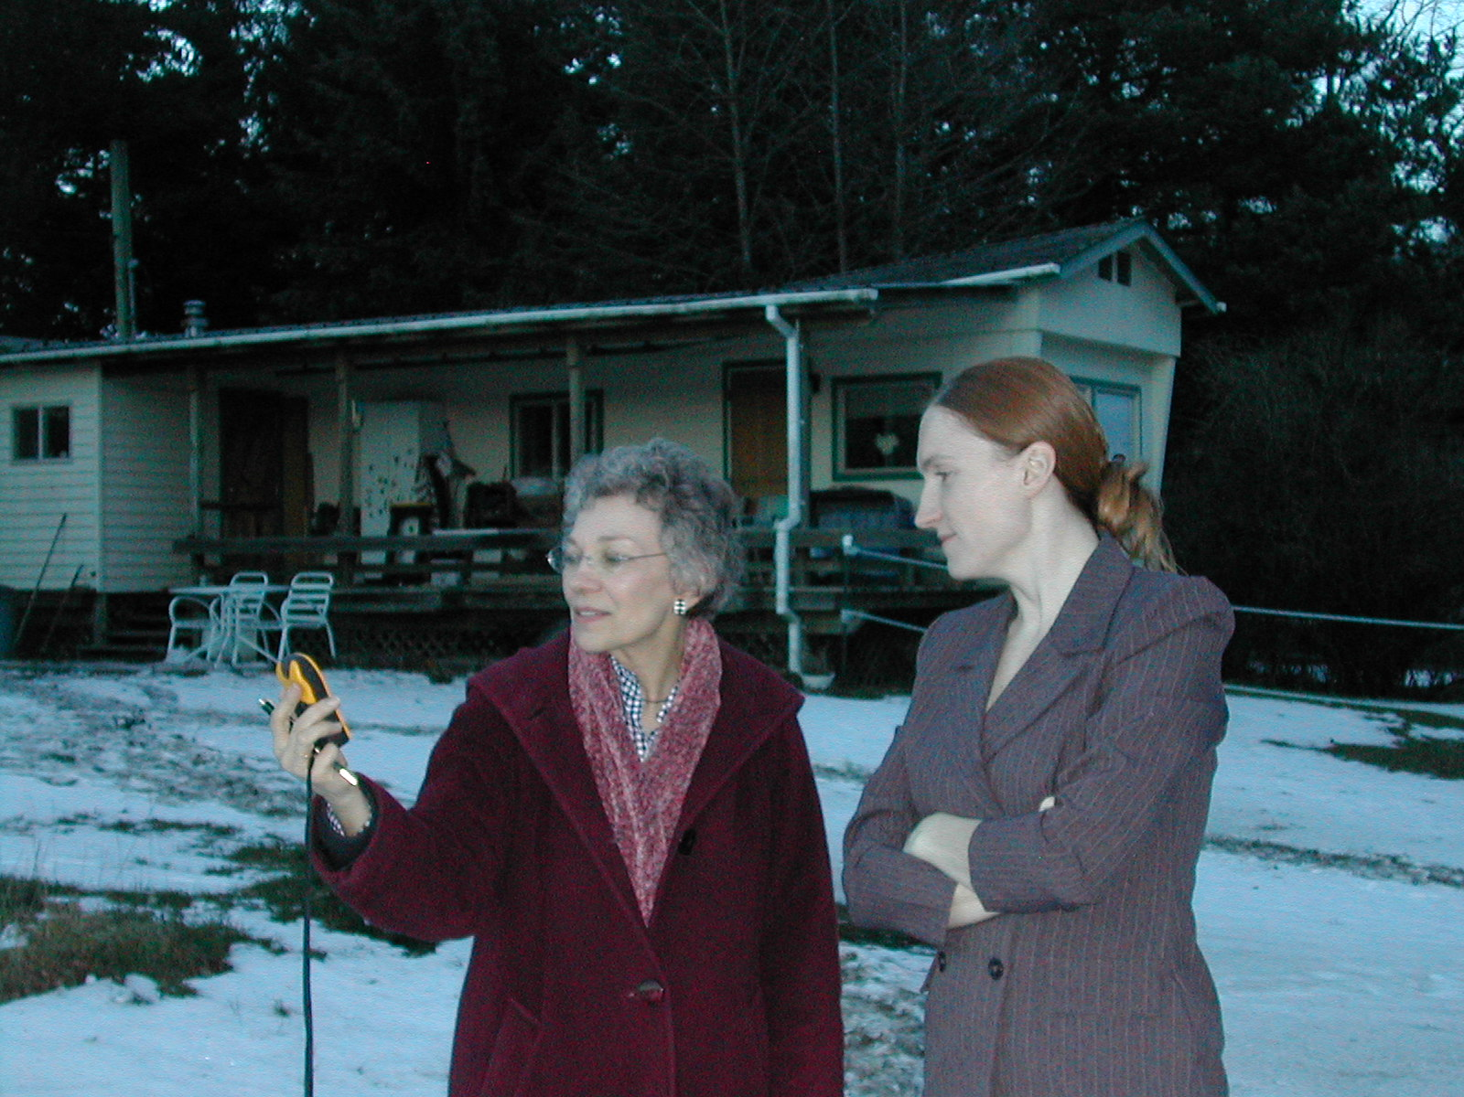
Many homes looked like this
Sylvia Fragner and Megkian Penniman, Ferndale, Washington

Slide 36
  26% of families did part of their primary job in their home or yard
  Yard activities included automotive repair (61.9%), wood working (50.0%), and cleaning and aging wild game (31.8%).

Slide 37
Risks: Radon
Airborne radon tested in Gallatin County only
28% of households above the threshold; homes above threshold were re-tested with a 90 day test
2-day levels ranged from 0-92 pCi/L

Slide 38
Risk: Mold
Indoor signs of water damage
74 (31%) homes
Elevated wood moisture equivalent (>18%) readings in 38 of these 74 homes

Slide 39
Risk: Carbon Monoxide
20 (9%) of households
40-264ppm

Slide 40
Risk: Blood lead
3 of 350 (<1%)
5.5-9.2 μ/dL

Slide 41
Risk: environmental tobacco smoke
Specimen: salivary cotinine
12 of 388 children (3%) above threshold
5.1-86.3mg/L

Slide 42
Risk: biologic and chemical contaminants in drinking water

Slide 43
Total coliforms in 39 (17%) of water samples
E.coli in 2% of samples

Slide 44
4 homes with elevated nitrate levels
(12.8-15.4mg/L)

Slide 45
4 households with detectable levels of VOCs (e.g., toluene, chloroform)

Slide 46
Child’s photo is inserted to personalize the intervention;
“windows” include information and test results

Slide 47
“Window” open with text results provided to mother

Slide 48
Outcomes of RCT self efficacy precaution adoption

Slide 49
Macro-determinants: Ecologic- or societal- level antecedents
Physical-spatial
Economic-resources
Cultural-ideologic
EH Inequities: Differential distribution of resources available at the family level
EH risks
interventions
Risk perception
Proximal
outcomes
Distal
outcomes
The TERRA framework: Translational Environmental Research in Rural Areas

Slide 50
Proximal outcome: Self-efficacy
“I know how to reduce my family’s risk to carbon monoxide.”
“I know where to find answers to my questions about risks in my home.”

Slide 54
Proximal outcome: Precaution adoption
I’m unaware….
I’ve decided to take action….
I’ve taken action…..

Slide 55
Precaution Adoption: Intervention and Control Groups at 3 months
 |  | Intervention (n=119) | Control (n=116) |  | Group Effect Odds Ratio (95% CI) p-value
3 or more EH risks |  | 83 (69.8) | 44 (37.9) |  | 3.9 (2.2,6.7) <0.0001

Slide 56
Risk |  | Intervention (n=119) | Control (n=116) | Group Effect Odds Ratio (95% CI) p-value
Radon |  | 70 (58.8) | 55 (47.4) | 2.4 (1.1,5.2) 0.03
Carbon monoxide |  | 61 (51.3) | 35 (30.2) | 2.4 (1.4,4.2) 0.001
Lead |  | 73 (61.3) | 40 (34.5) | 3.0 (1.8,5.1) <0.0001
2nd hand smoke |  | 29 (24.4) | 23 (19.8) | 1.3 (0.7, 2.4) 0.40

Slide 57
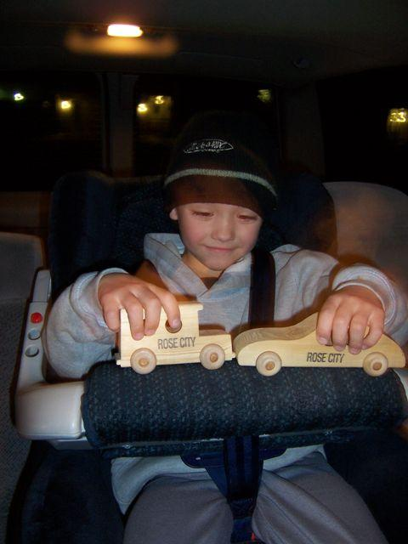
Implications:
“no one thing” was found, but 64% of households had at least one risk above threshold levels.

Slide 58
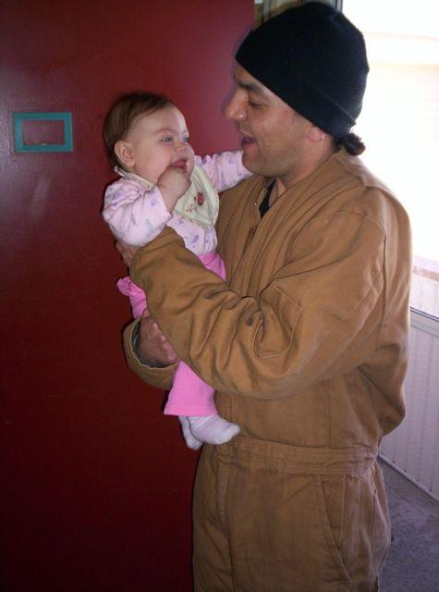
The public health nursing intervention was effective compared with usual and customary practice.
1st study of a PHN intervention using a randomized controlled trial in rural communities

Slide 59
Limitations:
-atypical rural communities
-high educational levels

Slide 60

This 5 year study provided evidence that rural public health departments can have an impact on household environmental health in low income families.

Slide 61

We wish to inform public health funders and policy makers about the impact household environmental health interventions can have.

Slide 62
Thank you
Patricia Butterfield, PhD, RN, FAAN
pbutter@wsu.edu

